Slide 1
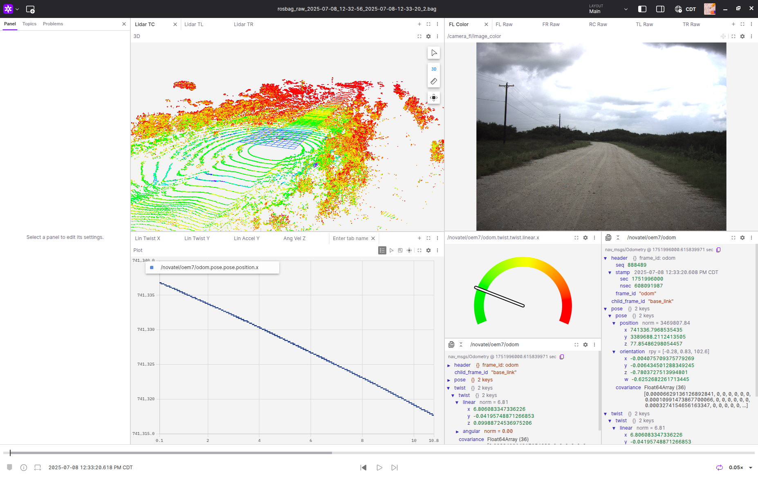
Foxglove
I created a helpful layout in which you could access many different topics easily. There are four main quadrants, each with different tabs to switch between similar topics.

Slide 2
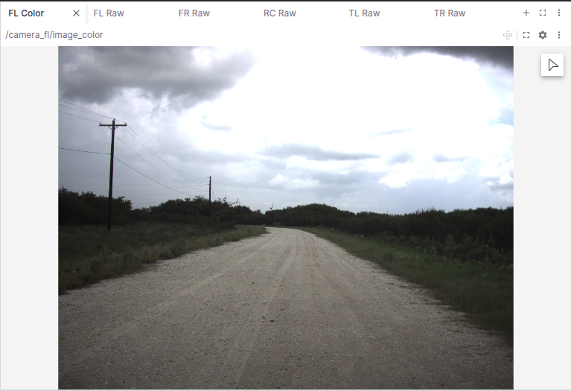
Quadrant 1
Quadrant 1 includes the image from the cameras. Each tab is a different camera, and the side cameras are flipped to make the image similar to the others.

Slide 3
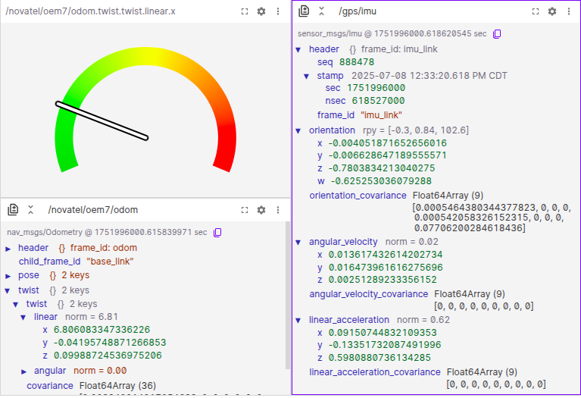
Quadrant 2
Quadrant 2 includes a gauge that is set on the X Linear Twist . Also, below that is the full odom topic on display so that the value for the gauge is shown. To the right is a display that can be set to any topic. In this case, it is set to the IMU topic.

Slide 4
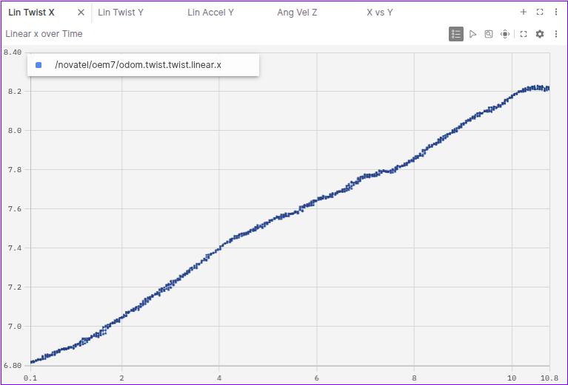
Quadrant 3
Quadrant 3 includes several different plots that display an array of information. For example, it can show x position relative to time, x position in relation to y position, or, in this case, X Linear Twist over time. This is useful because it gives a graph of the data, and when the mouse is over the graph, it displays specific data points.

Slide 5
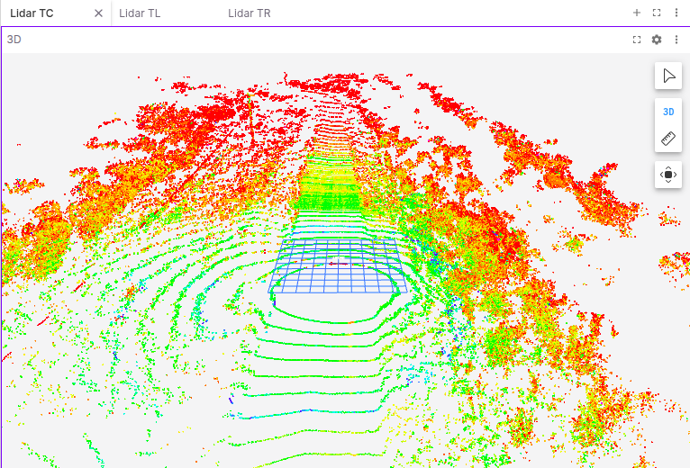
Quadrant 4
Quadrant 4 includes the 3D rendering of the different lidar sensors.

Slide 6
Read CSV
I wrote a python script that takes a .csv file from one of the Rosbag recordings and calculates meaningful data from it, such as average velocity, max speed, vibration analysis, comfort, and graphs of vibrations.
To use this script, simply go to the correct folder in terminal and input:
Python3 read_csv.py filename.csv

Slide 7
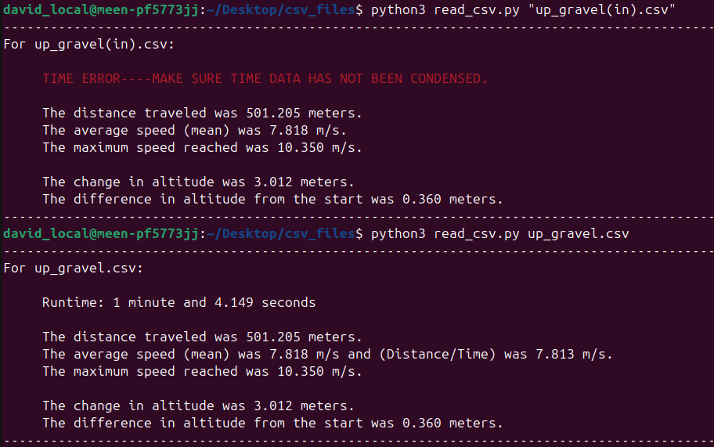
Finding Time
There is some difficulty in finding the time. Since the rosbag's time data is stored in GPS time, the number is very large. When using this code, make sure not to open the csv file in Excell first because the very large number will be condensed and the time calculation will display an error, though it will still display the rest of the information that is independent of time.
To find the run time, I subtracted the first time point from the last time point. It is then converted into seconds before displaying in the terminal whether it is in terms of hours, minutes, and/or seconds.

Slide 8
Total Distance, Average Speed, Maximum Speed
Total (planar) Distance is calculated by finding the difference between each position point (x and y), creating a vector with the Pythagorean Theorem, then adding all of these to find the total.
Average speed is calculated two different ways, total distance over total time, and the mean of the recorded x twist
Maximum Speed is found by finding the highest value in the x twist.

Slide 9
Change in Altitude and Difference in Altitude
Change in altitude is determined by taking the z position, finding the difference between each point, then adding the absolute values of these all together.
Difference in altitude is the final z position value minus the first z position value.

Slide 10
Max Acceleration and Max Change in Acceleration
Maximum Forward acceleration is just the largest value in the x acceleration data.
Also displayed in Gs.
Maximum change in acceleration (jerk) is found by taking the xyz accelerations and creating a single vector, for each value of xyz accelerations, then making a list of the absolute difference between each. From this new list, the largest value is displayed, along with the timestamp in seconds.

Slide 11
Vibration Analysis
To analyze the x, y, and z accelerations into meaningful data, there is first a butterworth filter applied to the information (default is a low pass filter of 3 Hz, but that can be changed).
This data is then displayed alongside the raw data in a graph that is opened on a browser. There is also a graph of the total vectors that is used for event detection.
In addition to this, the raw data is filtered with a different butterworth filter (default low cutoff of .5Hz and a high cutoff of 20Hz). This xyz filtered data is then combined into a single vector list, then an average is taken, giving a number that shows the comfort during the run. The larger the comfort index, theoretically the rougher the road type is. The possible road type is displayed.
Note: a poorly paved road could have a similar comfort index to a gravel road.
Speed would need to be taken into account for more accurate information on road type.
Also, the RMS of the raw acceleration data is calculated and displayed.

Slide 12
Vibration Analysis Cont.
In addition to these is event detection. This detects how many times there is an acceleration event (ex: a large bump or pothole) by comparing the full vector data(with a low pass filter) to a set number (default of 1.5 meters per second squared) and finds the times the data peaks above the set number.
With this information, the number of events is compared to the total time passed, displaying the average time between acceleration events.

